Slide 1
Modeling Population with Exponential, Logistic, and Gompertz
Isaac Dhyanchand

Slide 2
Data & Setup
Target: measure population over time (P(t))
Populations from US and World datasets
Used first data point as initial condition (P(0))
Units consistent: t (years), r (1/yr), K (people)
Test data: reserved a later year to test predictions
Judged fit by R^2 value.

Slide 3
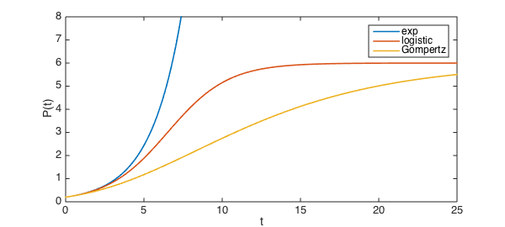
Models
Exponential: dP/dt = rP → doesn’t slowdown
Logistic: dP/dt = r(1 − P/K)P → approaches K quickly
Gompertz: dP/dt = r ln(K/P) P → approaches K slower.

Slide 4
Limitations
Data Limits
Possible miscounts
Model Limits
Models are constant throughout time
Carrying capacity is an estimate
Doesn’t measure migration, age structure, etc.

Slide 5
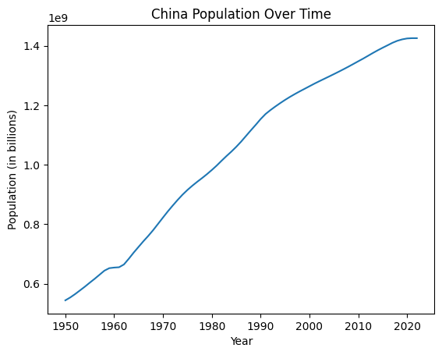
Parameter Estimation: K (Carrying Capacity)
China’s population (similar characteristics to US)
Ratio: Size/Population
Used China to build a L parameter for the US
K = 1.541 billion (for US)
Poor predictor for size of world
Estimated 15 billion

Slide 6
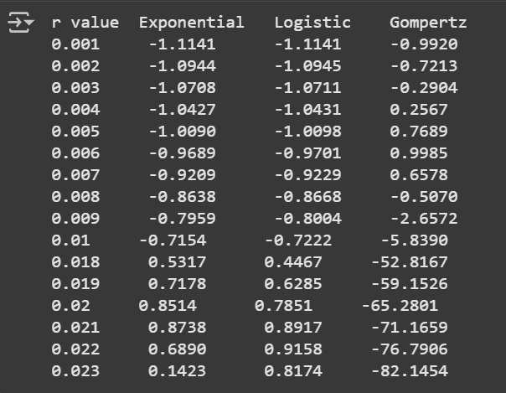
Parameter Estimation: r (Growth rate)
Tested multiple different r-values
Found r-values with best R^2 value
Expo - 0.021
Logistic - 0.022
Gompertz - 0.006

Slide 7
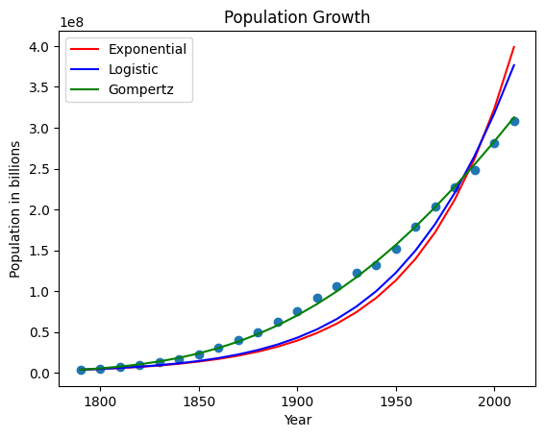
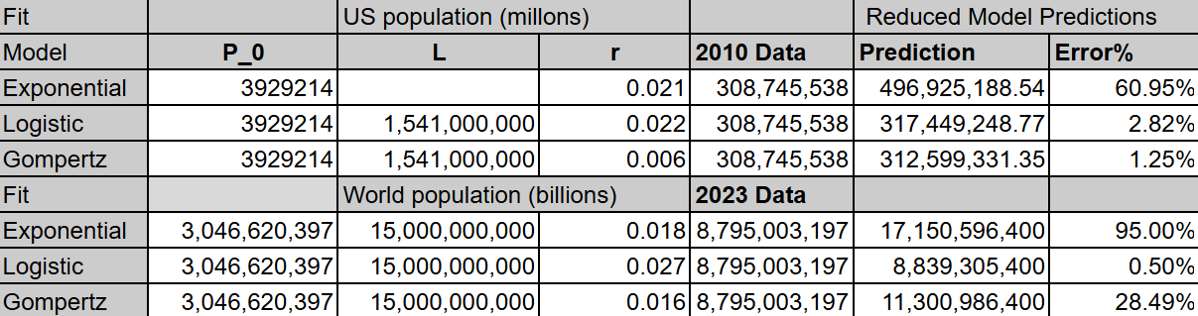
Results: USA Case
Gompertz best on prediction (lowest error)
Logistic close second
Exponential fails on long term predictions badly

Slide 8
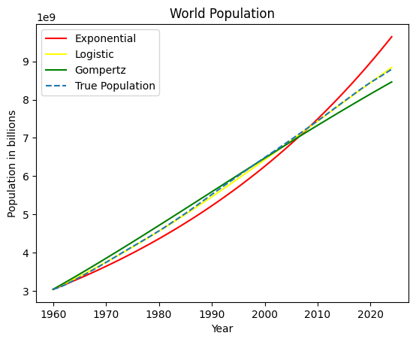
Results: World Case
Logistic better than Gompertz
Exponential again weakest

Slide 9
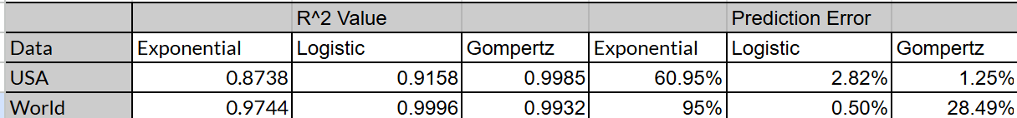
Conclusion
Logistic/Gompertz fit slowed growth best.
Exponential overpredicts over longer periods of time
Model isn’t perfect, but can be good for short-term predictions.

